Slide 1

Project - 33
Employees Evaluation for Promotion.

Slide 2
Description:
Employees evaluation for the Promotion in HR department The HR team stored data of promotion cycle last year, which consists of details of all the employees in the company working last year and also if they got promoted or not, but every time this process gets delayed due to so many details available for each employee - it gets difficult to compare and decide. So this time HR team wants to utilize the stored data to make a model, that will predict if a person is eligible for promotion or not. Need to come up with a model that will help the HR team to predict if a person is eligible for promotion or not.

Slide 3
Objective:
Explore and visualize the dataset.
Build a classification model to predict if the customer has a higher probability of getting a promotion.
Optimize the model using appropriate techniques.
Generate a set of insights and recommendations that will help the company.

Slide 4
Type Of Problem:
It is an classification Problem.
We can identify the classification problem by observing the output of the data, the output should be in a category,
Like, 0 or 1,
True or False,
Sunny or Rainy etc..,
As the outputs are in binary format like 0 or 1 It is an classification Problem.

Slide 5
Popular Classification Algorithms:
Logistic Regression
Naive Bayes
K-Nearest Neighbors
Decision Tree
Support Vector Machines

Slide 6
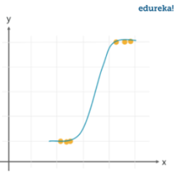
Logistic Regression

Slide 7
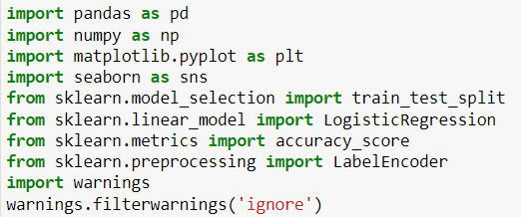
Importing Libraries:

Slide 8

Read the data:

Slide 9
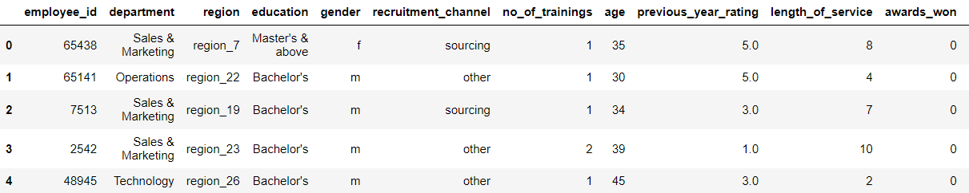
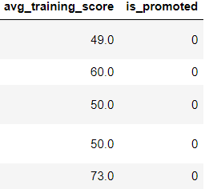

Slide 10

Shape of the data:

Slide 11
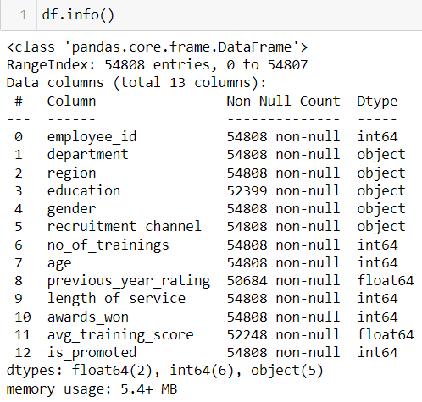
Data Information:

Slide 12
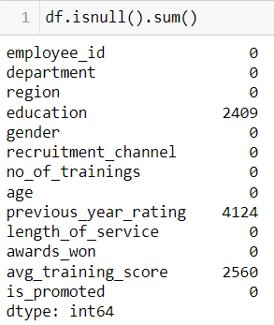
Null Values:

Slide 13
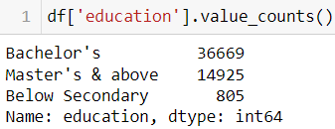
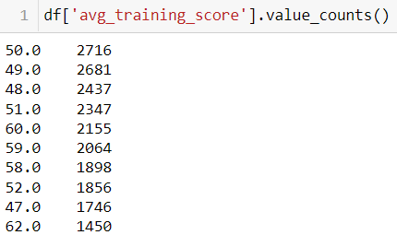
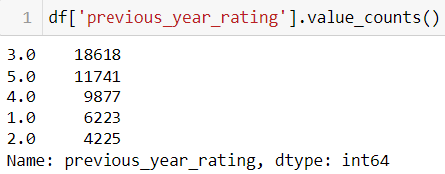
Unique values:

Slide 14
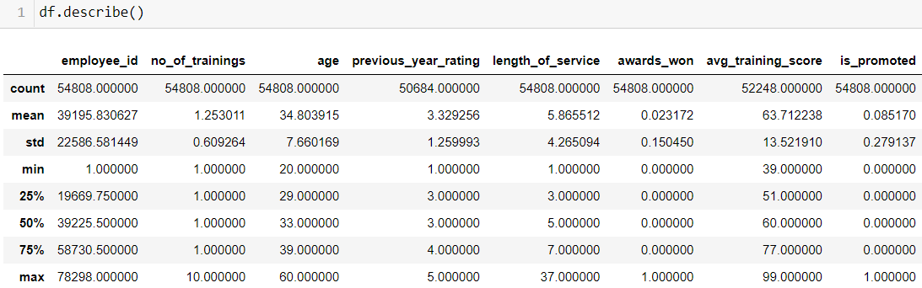
Statistical measures:

Slide 15
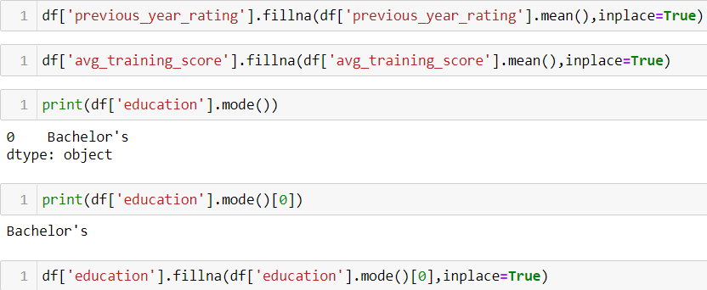
Filling Null Values:

Slide 16
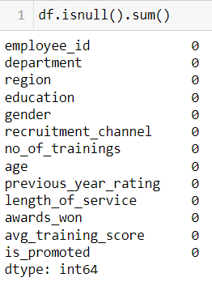
Null values:

Slide 17
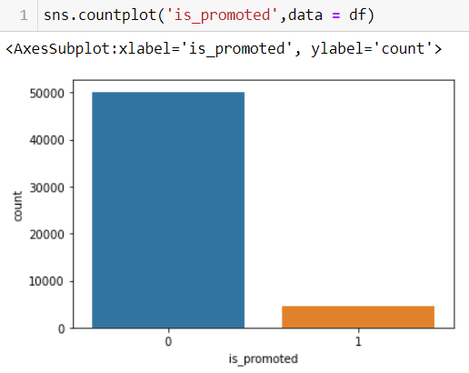
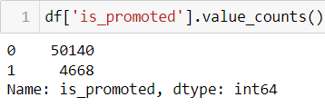
Visualization:

Slide 18
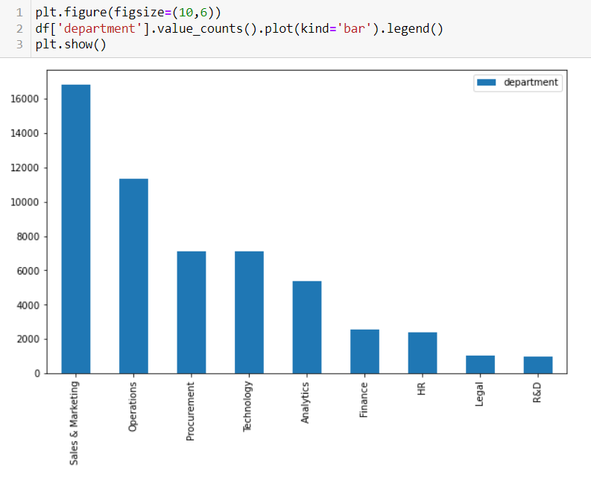
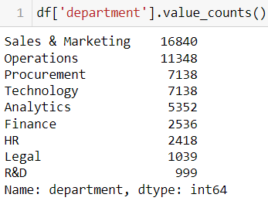
Department:

Slide 19
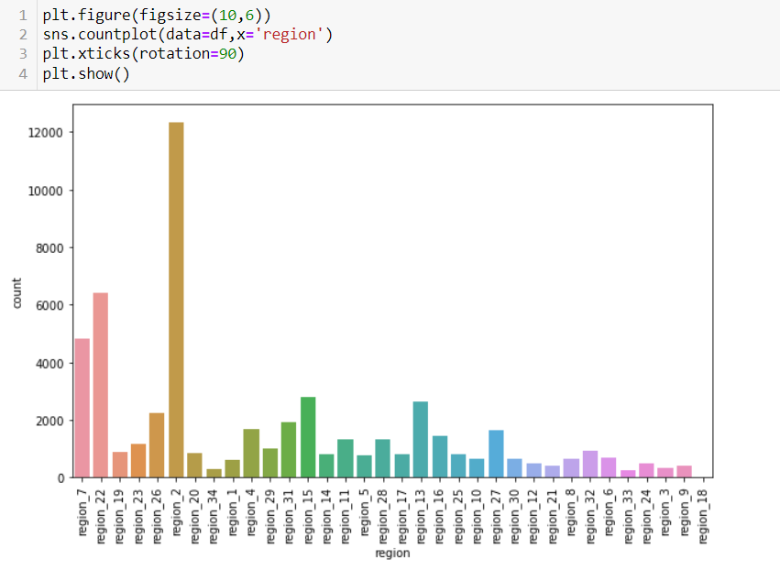
Region:

Slide 20
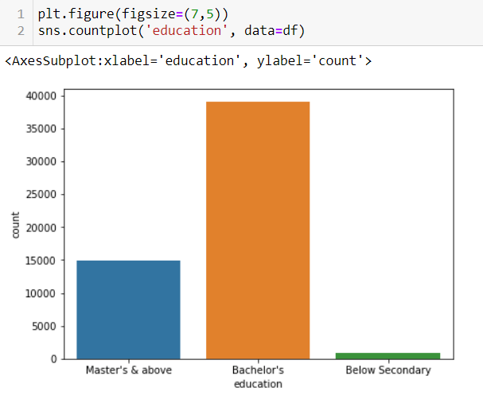
Education:

Slide 21
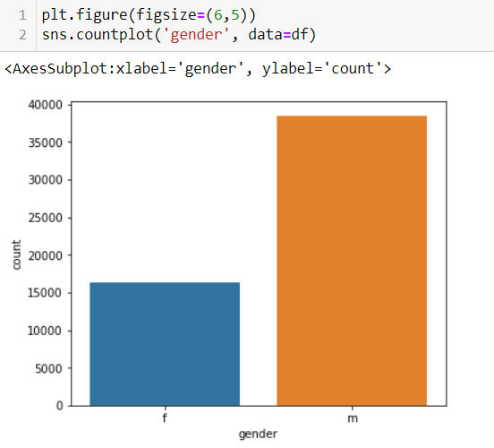
Gender:

Slide 22
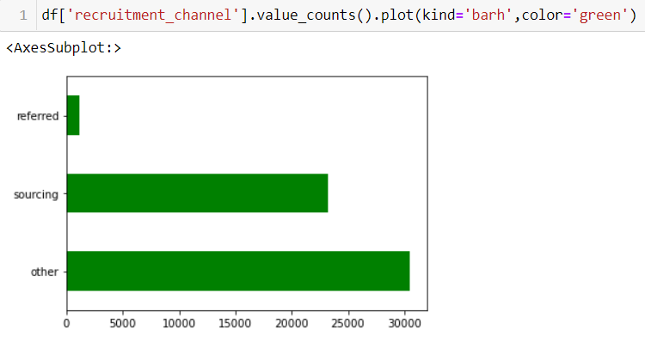
Recruitment Channel:

Slide 23

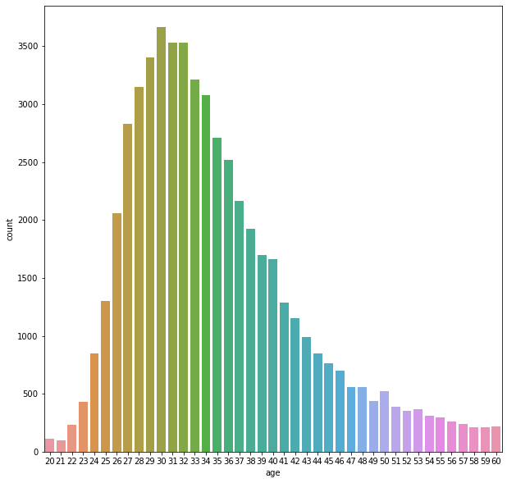
Age:

Slide 24
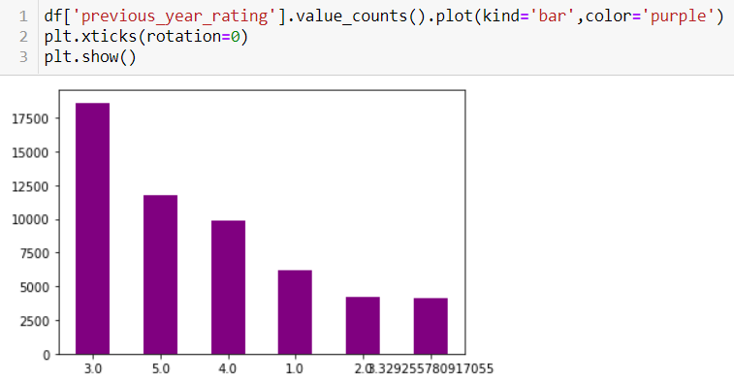
Previous year rating:

Slide 25
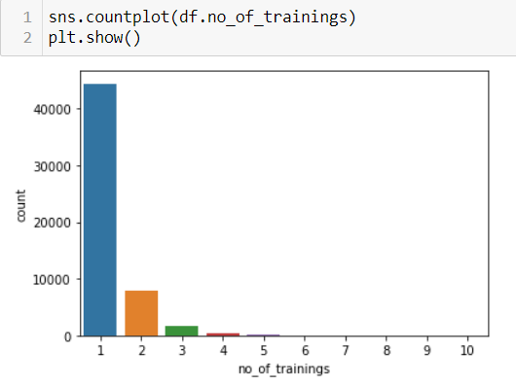
No of Trainings:

Slide 26

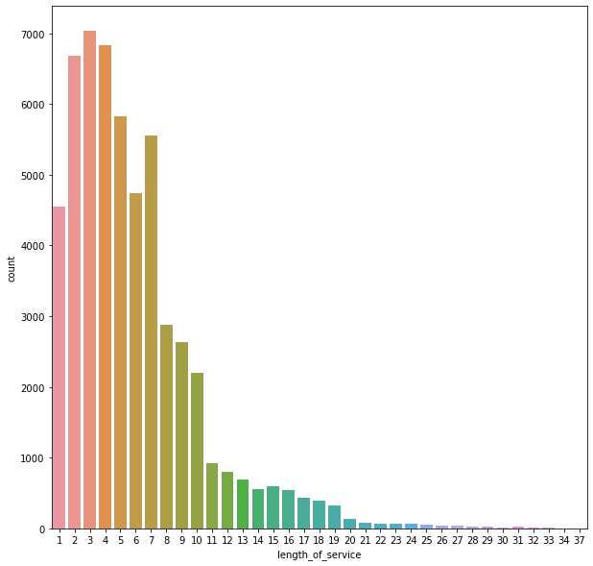
Length of Service:

Slide 27
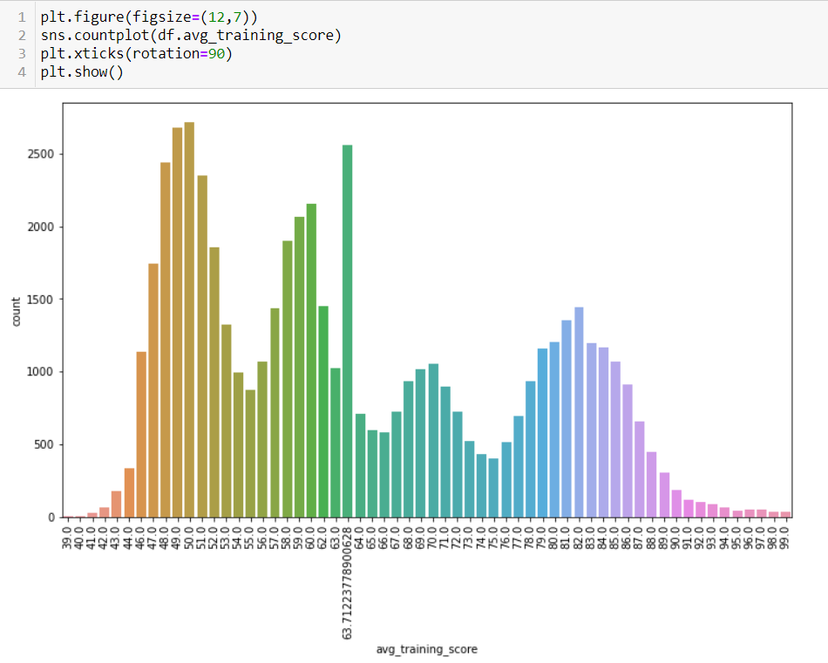
Avg Training Score:

Slide 28
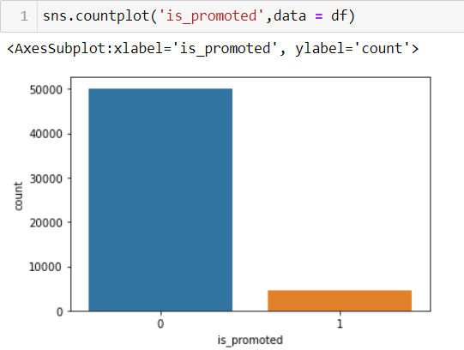
Promoted:

Slide 29
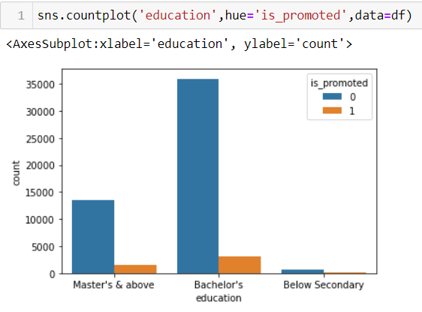
Education & Promoted:

Slide 30
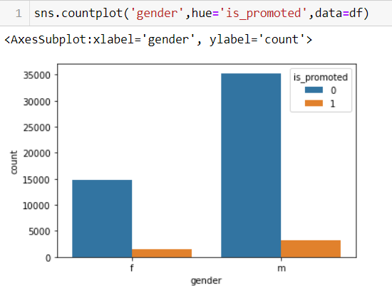
Gender & Promoted:

Slide 31
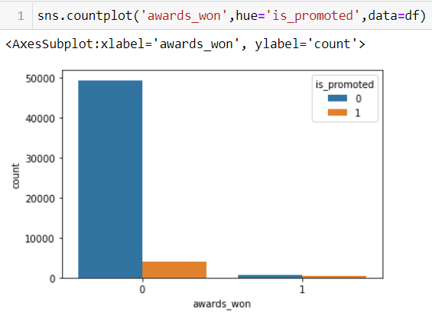
Awards & Promoted:

Slide 32
Drop:

Slide 33
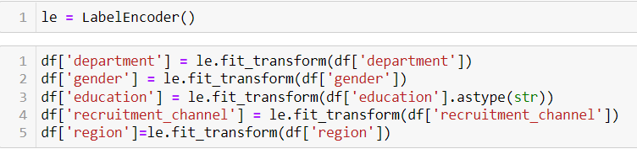
Label Encoding:

Slide 34
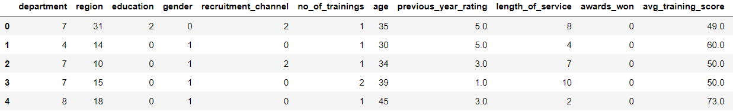
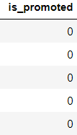
After label Encoding:

Slide 35
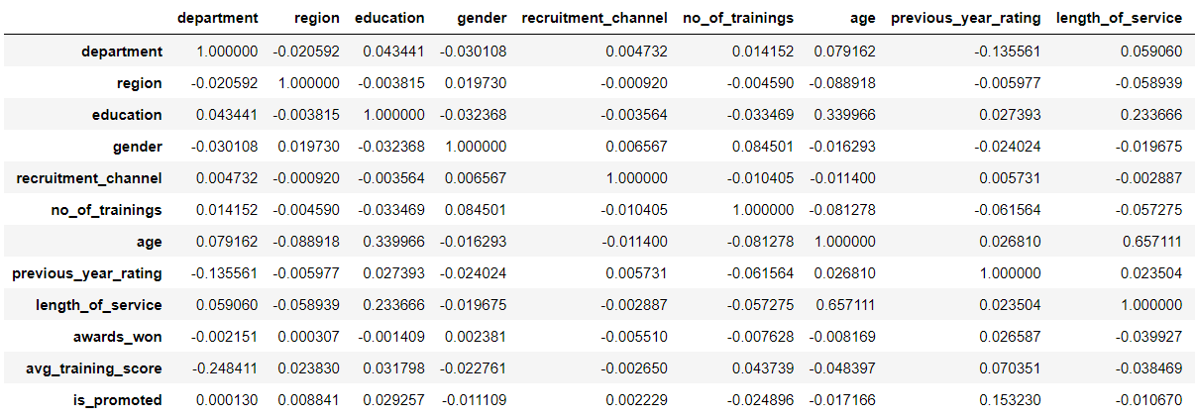
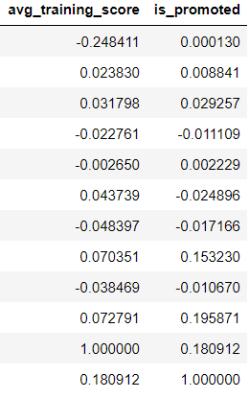
Correlation:

Slide 36
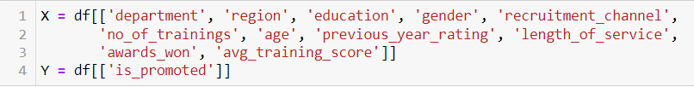
Splitting X and Y:

Slide 37
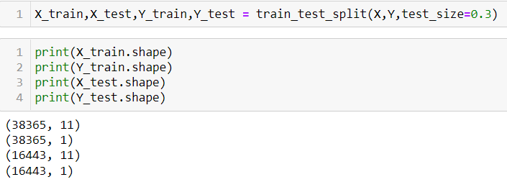
Splitting Train and Test Data:

Slide 38
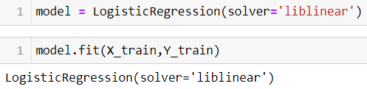
Creating Model:

Slide 39
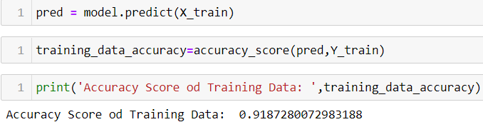
Training data Accuracy:

Slide 40
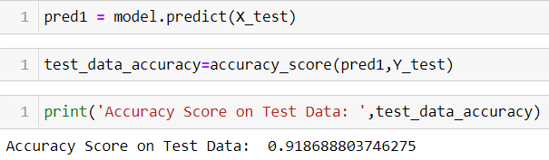
Test Data Accuracy:

Slide 41
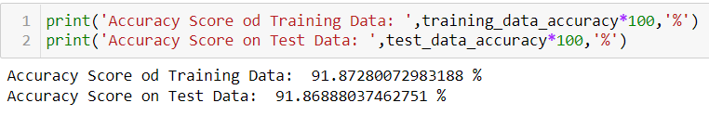
Accuracies:

Slide 42


